Slide 1

EMPLOYEE RETENTION

Slide 2
s
PROJECT NAME - HR ANALYTICS EMPLOYEE RETENTION
Team Members:
Ms : Sakshi Vijay Wagh
Mr : Shahrukh Ashik Sable
Mr : Yashwanth Naga kumar
Mr : Shafeer Khan
Mr : Prashant Punamchand Jadhav
Mentor -

Slide 3

AGENDA :
Introduction & Problem Statement
Business Objective
KPIs
Dashboard
Conclusion

Slide 4

Introduction: HR analytics involves the collection and analysis of HR-related data, including employee data, performance metrics, and other relevant data points. By using advanced analytical tools and techniques, HR analytics provides valuable insights into HR processes and trends, enabling organizations to make more informed decisions about their employees and improve overall performance.
Problem Statement:
Average attrition rate for all Departments
Average hourly rate of Male Research Scientist
Attrition rate Vs Monthly Income stats
Average working years for each Department
Job role Vs Work life balance
Attrition rate Vs Years Since last promotion

Slide 5
^{Business Objective:}
The aim of this project is to analyze employee retention and attrition rates with the organization and provide insights to the HR team for developing effective retention strategies. Through data analysis and visualizations, we will identify factors that contribute to :
Employee turnover and attrition.
Evaluate the effectiveness of existing retention strategies.
To verify the satisfaction level of employee in the organization.
Provide recommendations to improve employee retention.

Slide 6
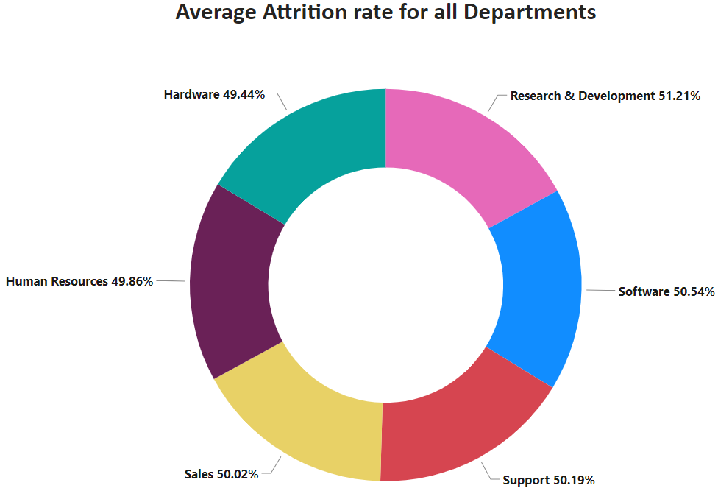
KPI1 : Average Attrition Rate For All Departments
Attrition Rate : 50.21%
This KPI is to find out the relationship between each
department and its attrition rate
Here attrition rate (51.21%) is highest for Research & Development Department.
Whereas lowest attrition rate (49.44%)is for Hardware Department.

Slide 7
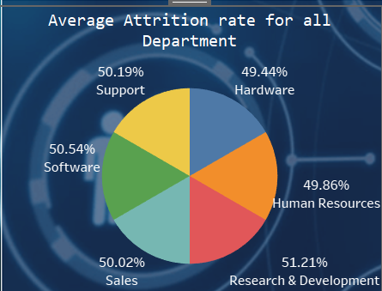
Insights from KPI 1:
We can clearly say that attrition rate of employees for every department is almost 50% which indicates that attrition rate of employees does not depends on department.
So, irrespective of the department almost 50% of employees are leaving the company.
From this calculation and visualization we concluded that we must make strong strategies to minimize attrition rate and improve our company’s Employee retention so that we can balance the company’s growth and right talent.

Slide 8

Observations
The attrition rates across all departments seem to be relatively close, ranging from 16.09% to 16.97%. This indicates a somewhat uniform distribution of attrition across the organization.
The Research & Development department has the highest sum of attrition rate (4,260.00) and contributes the highest percentage (16.97%) to the overall attrition rate. This suggests that attrition in this department is a significant concern and should be carefully addressed.
The Hardware department has the lowest sum of attrition rate (4,039.00) and contributes the lowest percentage (16.09%) to the overall attrition rate. While this might be seen as a positive aspect, it's essential to investigate further to ensure the low attrition rate is not due to dissatisfaction or other issues that might arise later

Slide 9
Suggestions
Focus on addressing attrition in the Research & Development department. Conduct exit interviews, employee surveys, and performance reviews to identify the reasons behind the high attrition rate. Implement measures to improve employee satisfaction, work-life balance, and career growth opportunities in this department.
Evaluate the reasons for the relatively high attrition rates in other departments, such as Sales, Software, and Human Resources. Consider implementing targeted retention strategies to reduce turnover in these areas as well.
Share the findings with department heads and managers to raise awareness about attrition trends in their respective teams. Encourage them to take proactive steps to retain valuable employees.
Monitor attrition rates over time and track the effectiveness of implemented measures to understand which strategies are working and which need adjustments.

Slide 10
Conclusion
The data shows that the organization as a whole has a moderate attrition rate, but there are variations across different departments. The Research & Development department experiences the highest attrition, while the Hardware department has the lowest attrition. This indicates that there might be specific challenges in retaining employees in certain areas.
To address attrition effectively, it is crucial to take a department-specific approach. Identifying the root causes of attrition in each department will help design targeted retention strategies that can improve overall employee satisfaction, engagement, and retention across the organization. By implementing measures to address attrition, the company can reduce turnover, maintain a stable workforce, and ultimately improve productivity and overall performance.

Slide 11
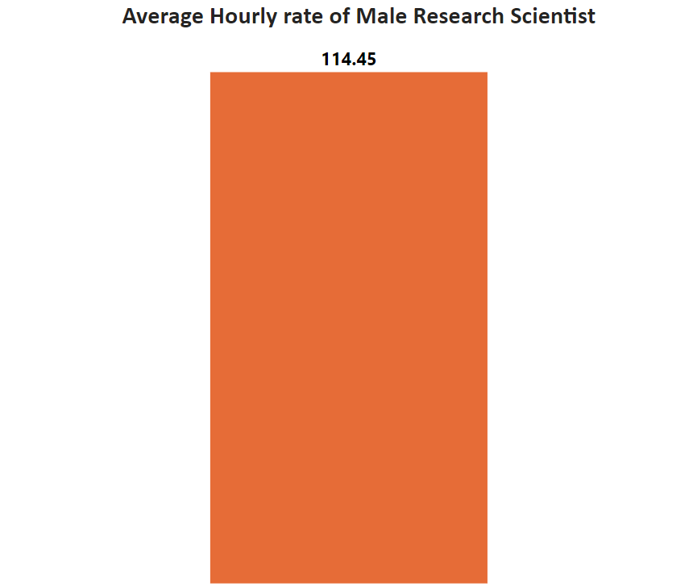
KPI 2 Average Hourly rate of Male Research Scientist
Insights from KPI 2 :
This KPI is to find out average hourly rate of male research scientists which is 114.45.

Slide 12
Observations:
The data represents the average job satisfaction scores for different job positions within the organization.
The job satisfaction scores are quite close to each other, ranging from 114.18 to 116.29, indicating a relatively consistent level of satisfaction across job roles.
The Healthcare Representative position has the highest average job satisfaction score (116.29), suggesting that employees in this role are generally more satisfied with their jobs.
The Developer position has the lowest average job satisfaction score (114.18), indicating a possible area of concern.

Slide 13
Suggestions:
Focus on
Focus on understanding the factors contributing to the lower job satisfaction among Developers. Conduct surveys, one-on-one interviews, and team discussions to identify specific pain points.
Implement
Implement initiatives to address the identified concerns, such as providing growth opportunities, recognition, and work-life balance improvements for Developers.
Recognize and reward
Recognize and reward high-performing employees in all job positions to boost overall job satisfaction.

Slide 14
Conclusion:
The data shows that overall job satisfaction is relatively consistent across various job positions in the organization. However, it highlights the need to pay special attention to the Developer position, as it has the lowest average job satisfaction score. By proactively addressing the concerns of Developers and implementing strategies to enhance job satisfaction, the organization can foster a positive work environment, improve employee retention, and increase overall productivity and performance.

Slide 15
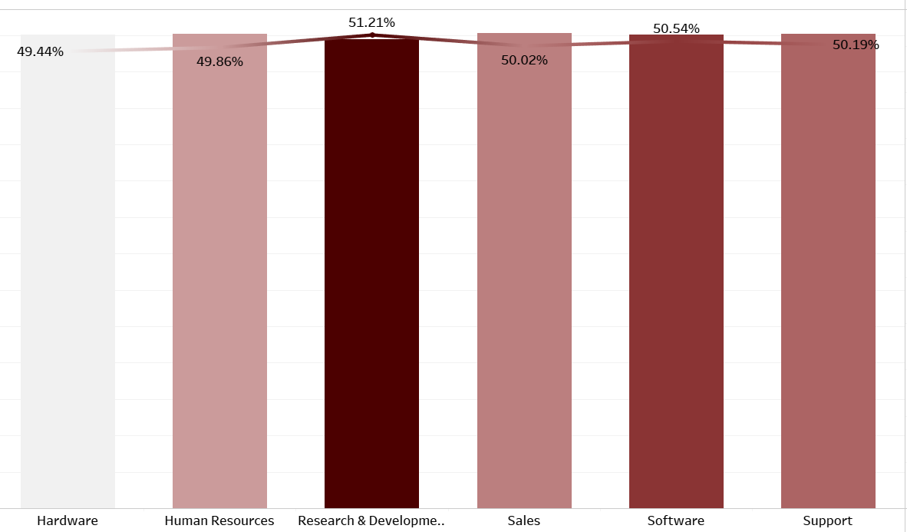
KPI3 : Attrition Rate Vs Monthly Income statistics
This KPI is to find out the relation the between monthly income and Attrition rate.
Based on our analysis and visualization, it is evident that the Hardwars the lowest attrition rate of 49.44%, with an average monthly income of Rs. 26,091.20.
On the other hand, the Research and Development Department has the highest attrition rate of 51.21%, with an average monthly income of Rs. 26,007.08

Slide 16
Observations:
The data presents the average monthly income and average attrition rate for each department within the organization.
The average monthly incomes are quite similar across departments, ranging from 25,726.08 to 26,118.75, indicating a relatively consistent salary structure.
The attrition rates for all departments are around 50%, with values ranging from 49.44% to 51.21%. This suggests that attrition is a common challenge across the organization.

Slide 17
Suggestions:
Although the average monthly incomes are consistent, it is essential to review market salary trends to ensure the organization remains competitive in attracting and retaining top talent.
For departments with higher attrition rates (e.g., Research & Development), conduct in-depth exit interviews and employee surveys to identify reasons for attrition and implement targeted retention strategies.
Enhance employee engagement programs and career development opportunities to increase job satisfaction and reduce attrition across all departments

Slide 18
Conclusion:
The data shows that the organization maintains a relatively consistent average monthly income for different departments. However, the attrition rates are a matter of concern, as they are around 50% for all departments. To address attrition effectively, the organization should focus on understanding the reasons behind employee turnover and implementing measures to improve employee satisfaction, growth prospects, and work-life balance. By adopting proactive retention strategies, the organization can reduce attrition, retain valuable talent, and foster a more stable and motivated workforce.

Slide 19
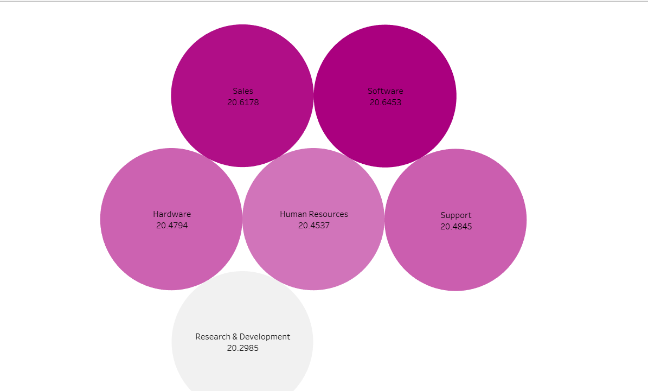
KPI4:Average Working Years for each Department
KPI4 : Average Working Year For Each Department
From this we can see the average working years in software department is high as compared to the rest of the departments and lowest is for Research & Development Department.
From the analysis we can conclude that average working years is approximately 20 for all the departments.

Slide 20
Observations:
The average working years for employees across all departments in the organization are quite consistent, ranging from 20.3 to 20.6 years. This suggests that employees, on average, have a similar level of work experience regardless of their department.
The Grand Total average of 20.5 years indicates that the organization, as a whole, has a stable and experienced workforce with an average tenure of approximately 20.5 years.

Slide 21
Suggestions:
While the average working years are consistent, it is essential to ensure that the organization continues to attract and retain young talent to maintain a healthy balance of experience and fresh perspectives.
Implement mentorship and knowledge-sharing programs to leverage the expertise of long-tenured employees and facilitate the onboarding and development of new employees.
Regularly assess employee satisfaction and engagement to identify any potential factors that may affect retention and motivation

Slide 22
Conclusion:
The data reveals that the organization has a stable and experienced workforce, with an average working tenure of approximately 20.5 years. This is a positive indication of the organization's ability to retain employees over the long term. However, to remain competitive and adaptable to changing industry dynamics, the organization should continue to focus on attracting and retaining young talent while leveraging the expertise of its experienced employees. By promoting a culture of learning, mentorship, and employee engagement, the organization can ensure continued success and growth in the future

Slide 23
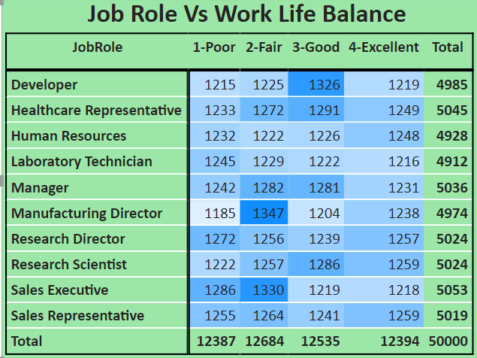
KPI5 : Job Role Vs Work Life Balance
From the analysis we can conclude the work life balance for the attrition employees as below,
For Research directors the work life balance is poor.
For the Sales representatives , Manufacturing Directors , managers and Sales executives the work life balance is fair.
For Research Scientists , Healthcare representatives und Developers the work life balance is good.
For Human resources , laboratory technicians the work life balance is excellent.

Slide 24
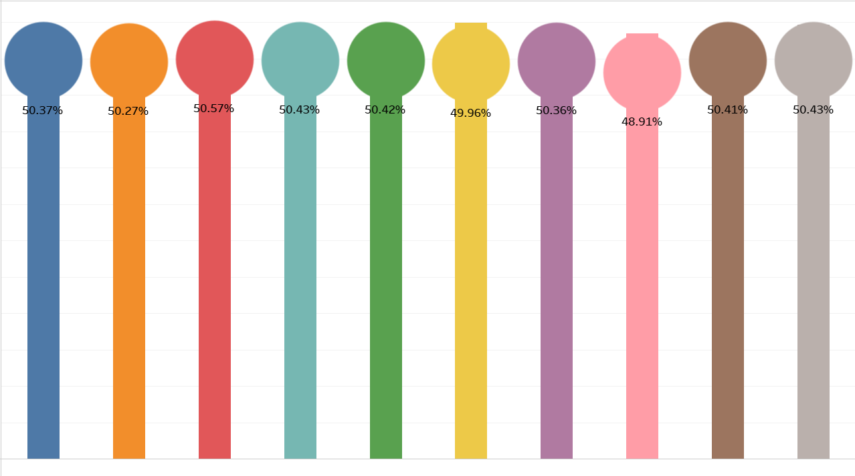
KPI 6 : Attrition Rate Vs Years Since Last Promotion

Slide 25
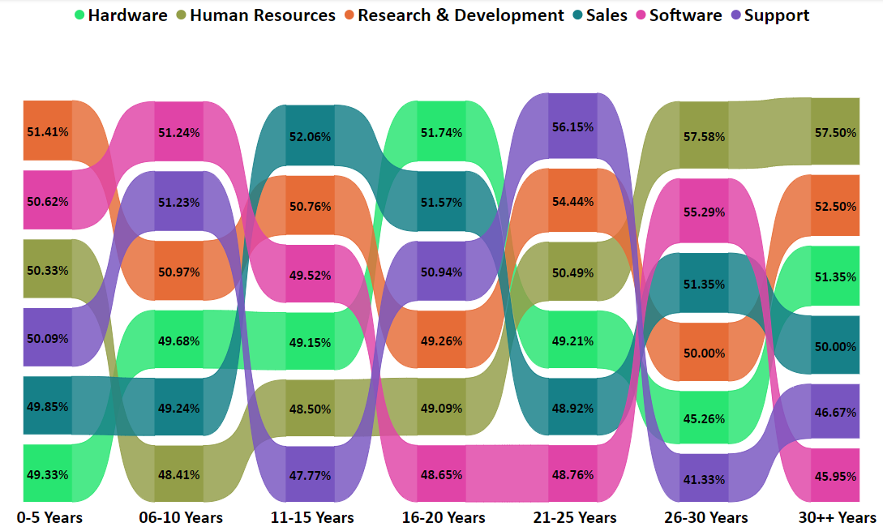
KPI6: Attrition rate VS Year Sincr Last Promotion relation
For 0-5 years since Last year Promotion interval Research & Development and Hardware departments has highest and lowest attrition rate respectively.
For 6-10 years since last year promotion interval Human resources and software departments has highest and lowest attrition rate respectively.
For 11-15 years since last promotion interval support and sales departments has highest and lowest attrition rate respectively.
For 16-20 years since last promotion interval software & hardware departments has highest and lowest attrition respectively.
For 21-25 years since last promotion interval software and support departments has highest and lowest attrition respectively.
For 26-30 years since last promotion interval support and Human resources departments has highest and lowest attrition respectively.
For above 30 years since last promotion interval software and Human resources departments has highest and lowest attrition respectively.

Slide 26
Observations:
The data presents two metrics for each job position: the attrition rate and the average monthly income.
The attrition rates for different job positions range from 48.91% to 50.57%, with the overall grand total attrition rate being 50.21%. This indicates that attrition is a common challenge across all job positions in the organization.
The average monthly income for job positions ranges from 5.74 to 6.00, with the overall grand total average monthly income being 5.87.

Slide 27
Suggestions:
The organization should closely analyze the factors contributing to higher attrition rates in certain job positions, such as Research Scientist (48.91%) and Manufacturing Director (49.96%). Conducting exit interviews and employee surveys can provide valuable insights into the reasons behind employee turnover in these roles.
For positions with lower attrition rates, such as Healthcare Representative and Human Resources, identify the best practices that contribute to higher employee retention and apply them to other job positions.
Review the salary structure of each job position to ensure competitiveness in the job market. If the average monthly income is below industry standards for certain roles, consider adjusting the compensation package to attract and retain top talent

Slide 28
Conclusion:
The data reveals that the organization is facing a common challenge of attrition across all job positions, with an overall attrition rate of 50.21%. To address this issue effectively, the organization should conduct thorough analyses to understand the specific reasons behind higher attrition rates in certain roles and implement targeted retention strategies. Additionally, ensuring a competitive salary structure that aligns with industry standards can play a crucial role in attracting and retaining skilled employees. By adopting a proactive approach to employee retention, the organization can create a more stable and engaged workforce, ultimately leading to increased productivity and overall organizational success.

Slide 29
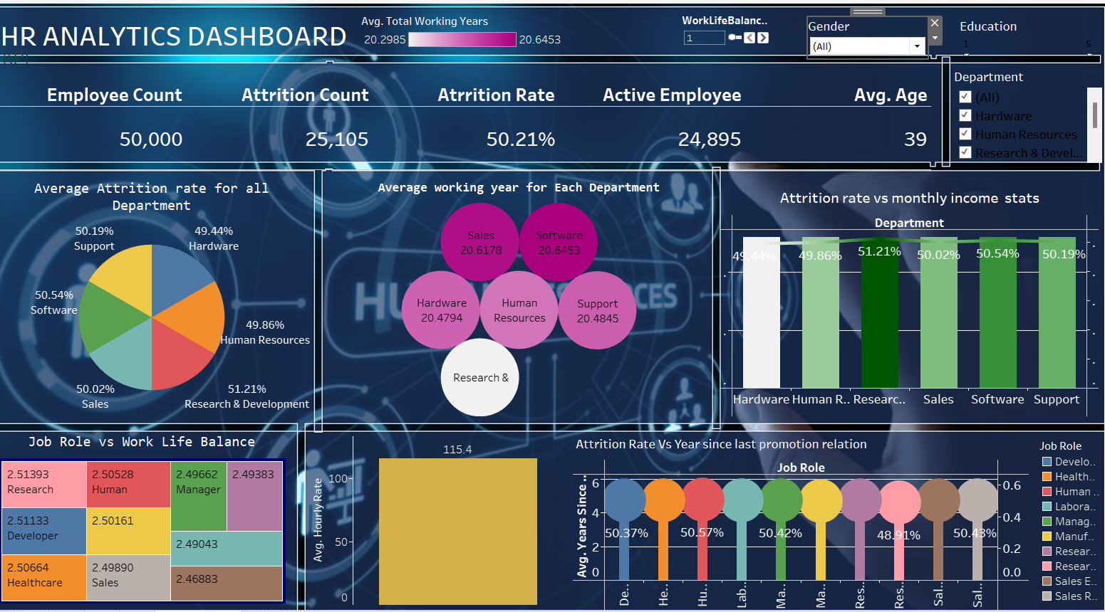
Dashboard

Slide 30
Conclusion
Conduct stay interviews: Instead of exit interviews, conduct stay interviews with employees to gather feedback about the job.
Improve employee engagement: Implement initiatives to improve employee engagement, such as regular feedback, recognition and rewards programs, and opportunities for career growth.
Address workload issues: Ensure employees have manageable workloads by regularly monitoring and adjusting workloads to prevent burnout and overwhelm.
Create a positive work environment: Foster a positive work environment by promoting a culture of respect, inclusivity, and teamwork. Encourage open communication and collaboration among employees.
Address pay and compensation issues: Ensure that employees receive fair pay and compensation for their work and to find out what motivates an employee to continue to work in an organization.

Slide 31

Thank you

